Slide 1
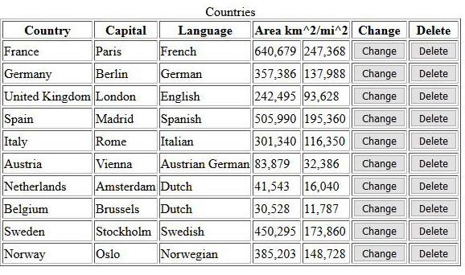
Homework 1
Task 1
Create index.html which will consist image (800px),
div with text(800px),list of item params and link to
items.html
Task 2
Create items.html which will consist table with next content:
-Title
-header row with 6 cell (4th cell span two ordinary cell, something like size) - item params
-10 data row with 5 data cell(4th and 5th cell like width height),6th and 7th cells like a button ('change' and 'delete') - attr. value
Task 3
Create item.html which will consist form to create/change new item (you don't need to fill the form,only create).
Task 4
Read this article (https://proglib.io/p/git-for-half-an-hour/), try to create your own GIT repo,github account, connect it and push your homework
LeverX Presentation. Copyrighted 2019 by LeverX, Inc. All Rights Reserved.

